Slide 1
Explaining Appropriate Cryptographic Solutions
CompTIA Security+ Exam SY0-701
Lesson 3
Notes:
This lesson completes the overview of basic concepts with an introduction to cryptography. Cryptography underpins many of the access control technologies that we will consider in the next block of lessons.

Slide 2
Objectives
Compare and contrast cryptographic algorithms
Explain the importance of public key infrastructure and digital certificates
Explain the importance of using appropriate cryptographic solutions for encryption and key exchange

Slide 3
Cryptographic Algorithms
Lesson 3
Topic 3A
Notes:
This topic covers the basic cryptographic primitive types: symmetric versus asymmetric ciphers and hashing.
Objective 1.4 is covered overall the topics in this lesson.
It is easy for students to become confused about the different types of cryptographic systems, so allocate plenty of time to covering this topic.

Slide 4
Cryptographic Concepts​
Encryption and decryption—encoding and decoding​
  Plaintext is the unencoded message​
  Ciphertext is the coded message​
  Cipher is the means of change or algorithm​
Cryptanalysis is the art of cracking cryptographic systems​
Meet Alice and Bob (and observe Mallory, lurking)​
Hashing algorithms​
Encryption ciphers​
  Symmetric​
  Asymmetric​​
Notes:
Note that in cryptography there is still some "obscurity" involved as you have to control distribution of the key. This is a simpler job than protecting the design of the algorithm, however.
Passive eavesdropping is traditionally performed by a character named Eve, but we're just using Mallory for simplicity.

Slide 5
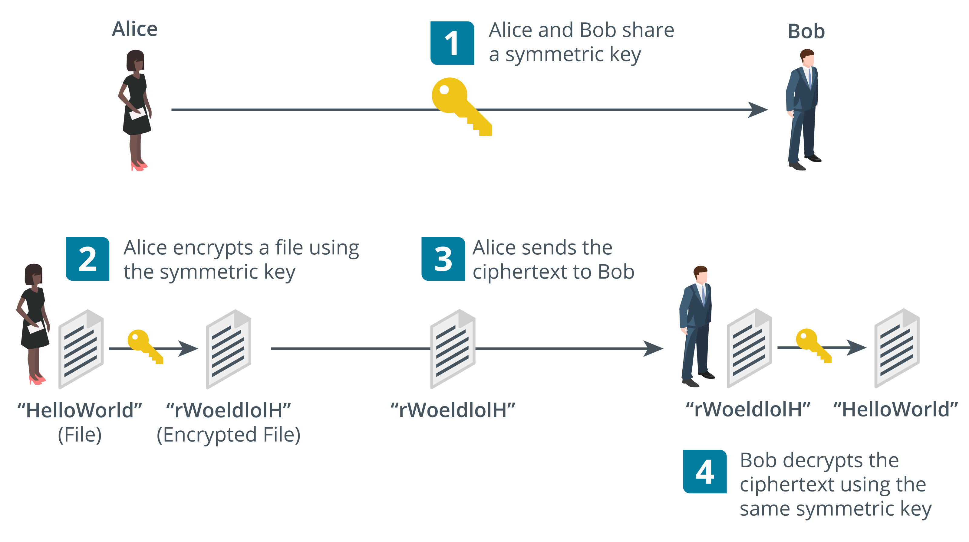
Symmetric Encryption
Encryption uses a reversible process (algorithm) based on a ​key that is only known by authorized persons
Substitution​ and transposition​
  Process should be too complex to unravel without the key​
Symmetric algorithms
  Same secret key is used for encryption and decryption​
  Fast—suitable for bulk encryption of large amounts of data​
  Problem storing and distributing key securely​
  Confidentiality only— sender and recipient know the same key​
Notes:
Make sure students understand the difference between the algorithm and the key.
Note that symmetric encryption is mostly used for privacy (confidentiality). Test that the students can explain to you why it cannot be used for authentication, integrity, or non-repudiation.
While the names of cryptographic algorithms have been removed from the certification objectives, they are still present in the acronyms list, and the injunction on the acronyms list is "Candidates are encouraged to review the complete list and attain a working knowledge of all listed acronyms as part of a comprehensive exam preparation program." Consequently, the names of some products have been retained.
Acronyms related to block ciphers/modes of operation are still present, but we are not covering this subject as it is complex and no longer listed as an exam subobjective. You might want to point students toward other sources to learn about these: CBC, CFB, CTM, ECB, GCM.

Slide 6
Key Length
Key ensures ciphertext remains protected even when the operation of the algorithm is known​
Range of key values is the keyspace​
Longer key bit length means a larger keyspace​
  Protects against brute force cryptanalysis
Advanced Encryption Standard (AES/AES256)​
  256-bit key is exponentially stronger than 128-bit key
  Larger keys use more CPU/memory/power resources
Notes:
Note that AES doesn't have weak keys. However, if the implementation uses weak random number generation, the keys will be much more vulnerable to cryptanalysis.
DES and RC4 remain in the acronyms list. You might want to mention these weak ciphers are no longer recommended for use. We're omitting discussion of IDEA and RACE too.

Slide 7
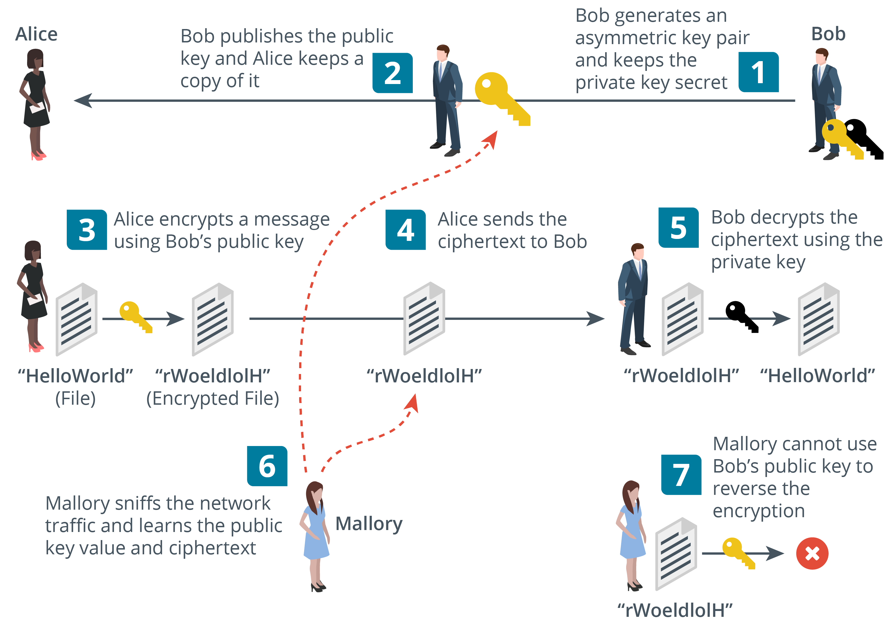
Asymmetric Encryption​
Public/private key pair​
  If the public key encrypts, only the private key can decrypt​
  Private key cannot be derived from the public key​
  Private key must be kept secret​
  Public key is easy to distribute (anyone can have it)​
Used for small amounts of authentication data​
Different ciphers have different recommended key lengths
  Rivest, Shamir, Adelman (RSA) cipher (2,048-bit or better)
  Elliptic Curve Cryptography (ECC) cipher (256-bit or better)
Notes:
Asymmetric ciphers are mainly used for authentication and non-repudiation and for key exchange.
The diagram is a simplified view of key exchange. Note that in real-world applications, the "file" will more typically be a symmetric secret key rather than a data file or network packet.

Slide 8
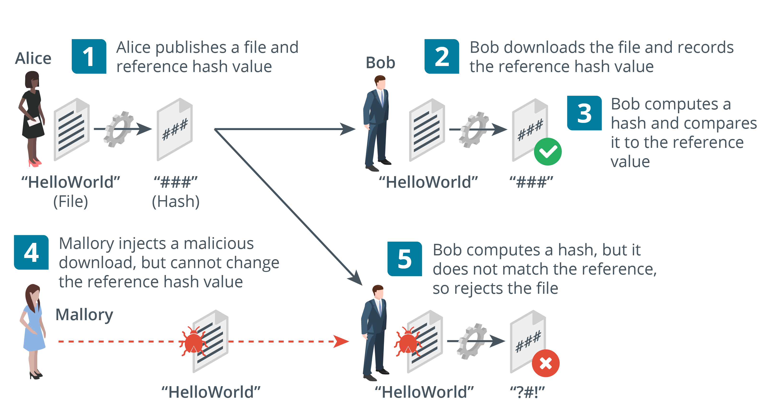
Hashing
Fixed length digest from variable string with cryptographic properties​
  One-way (plaintext cannot be recovered from the digest)​
  Anti-collision (no two plaintexts are likely to produce the same digest)​
Used for password storage and checksums (integrity)​
Secure Hash Algorithm (SHA)​
  256-bit or better
Message Digest Algorithm (MD5)​
  128-bit only
Images © 123rf.com.
Notes:
Hash functions are mostly used for integrity (signatures and message authentication codes) and password storage (confidentiality).
RIPEMD is also listed as an acronym so you might want to make students aware of it as an alternative to SHA.

Slide 9
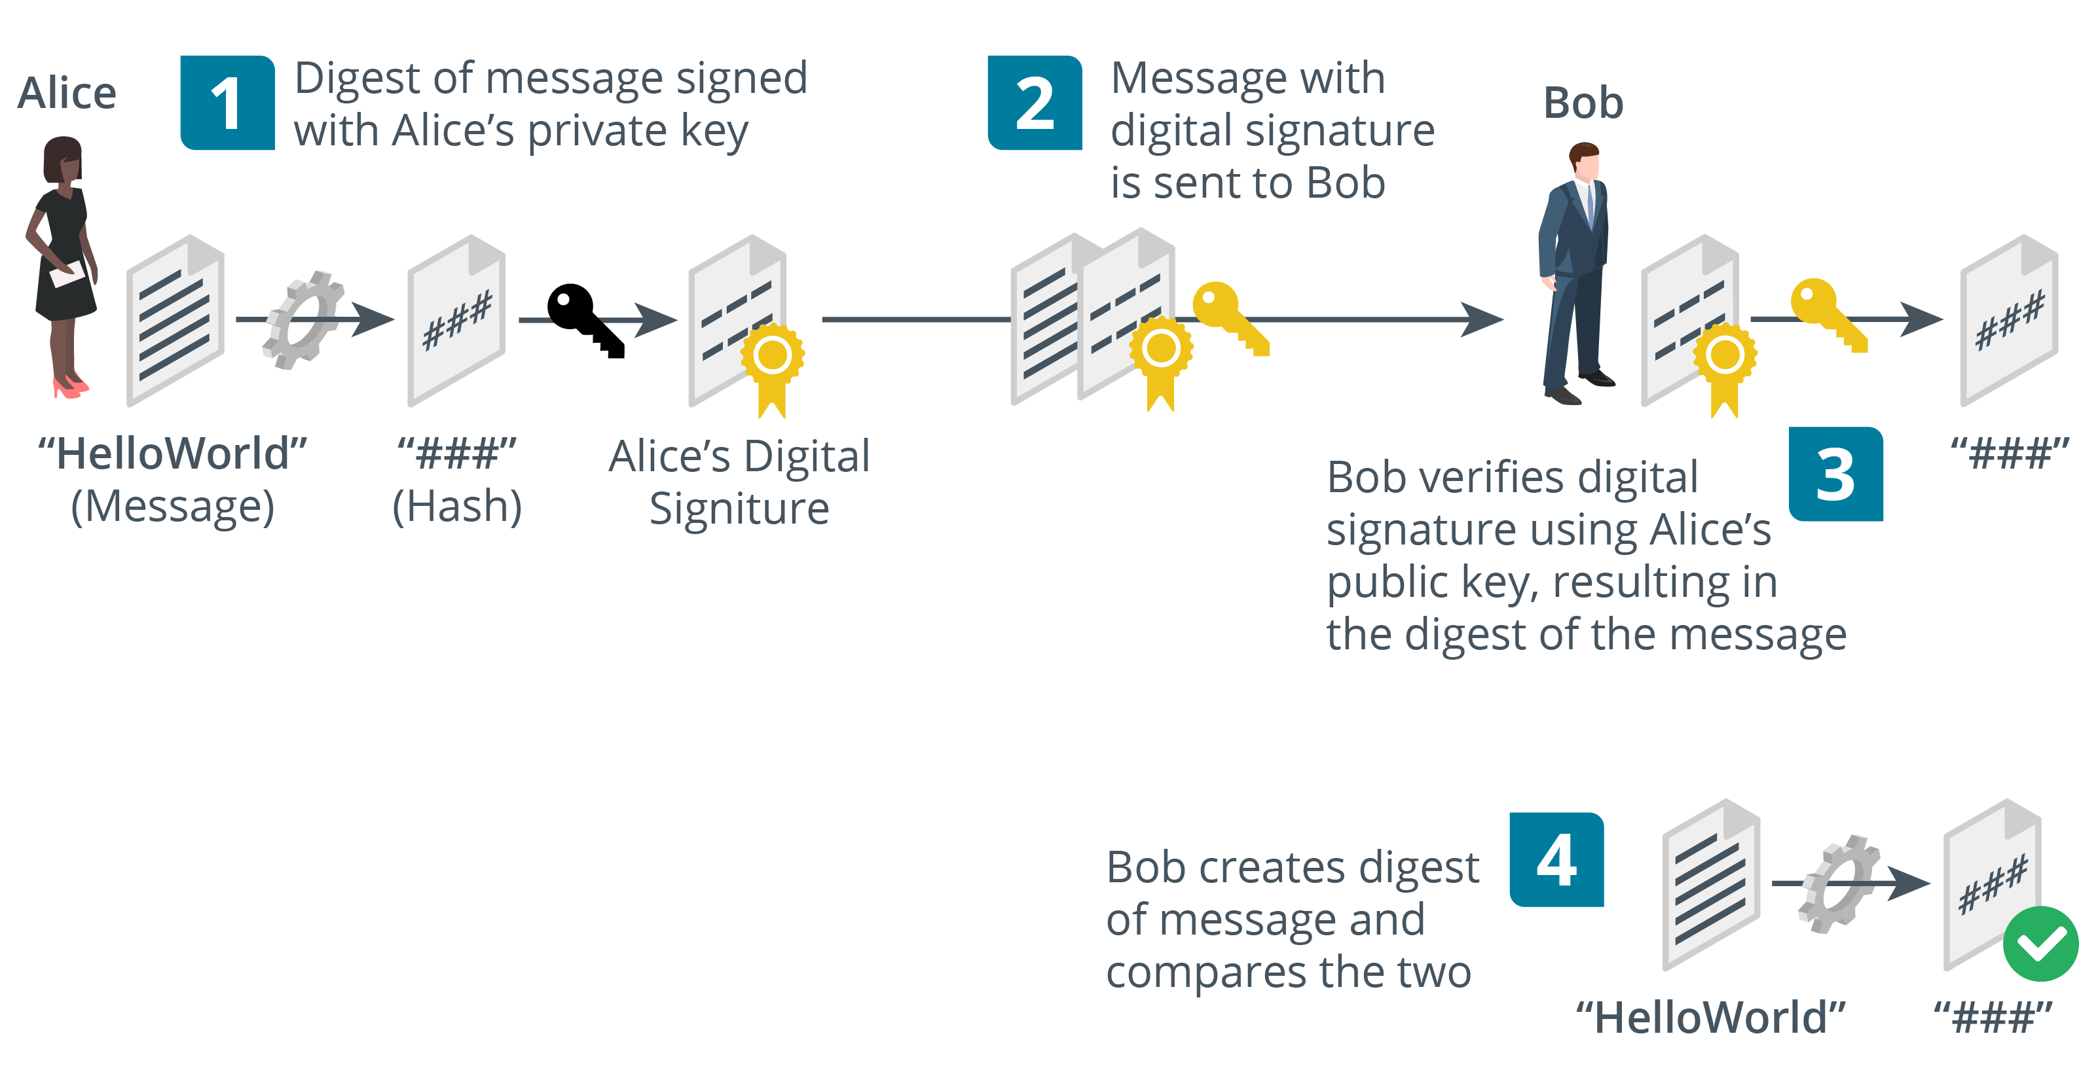
Digital Signatures​
Using public key cryptography with hashing​
Digital signatures provide integrity, authentication, non-repudiation​
Notes:
Digital signatures combine public key cryptography with hashing algorithms to provide authentication, integrity, and non-repudiation.

Slide 10
Cryptographic Algorithms
Cryptographic concepts​
Symmetric encryption
  Same secret key encrypts and decrypts
Key length
Asymmetric encryption​
  Public/private key pair
Hashing
  Non-reversible
Digital signatures​
  Sign message hash with private key and validate with public key

Slide 11
Applied Lab: Using Storage Encryption

Slide 12
Public Key Infrastructure
Lesson 3
Topic 3B
Notes:
As the previous lesson covered a lot of theory, you may prefer to focus more on labs for this topic. Most of the content examples are straightforward.

Slide 13
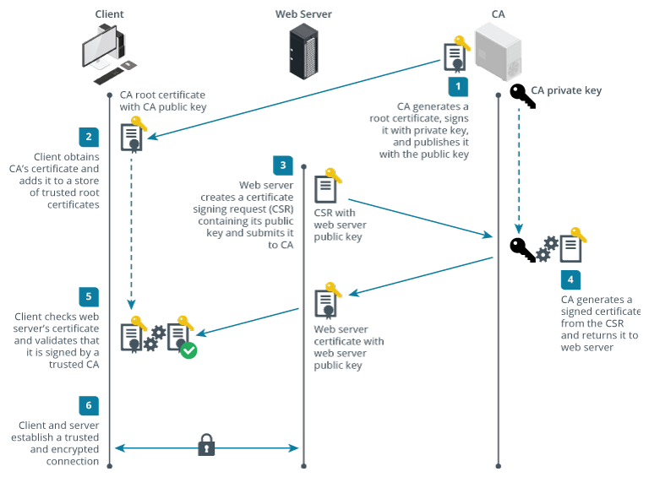
Certificate Authorities​
Public key infrastructure (PKI)
  Prove identity of a public key holder (subject user or computer)
Certificate authority (CA)
  Repository of certificates and public keys issued to verified subjects
Third-party CA
  Entity that has established widespread trust in its policies and procedures for issuing certificates
Notes:
This is a quick recap of the previous topic. Be sure that students grasp the use of public and private keys before moving on.

Slide 14
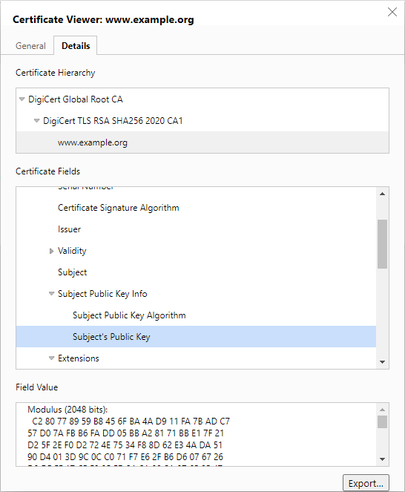
Digital Certificates​
Contains subject’s public key​
Information identifying the subject plus usage and validity​
Digital certificate standards​
  X.509 Public Key Infrastructure (PKIX)​
  PKCS (Public Key Cryptography Standards)​​
Notes:
X.509 and PKCS standards aren't listed in the exam objectives (though PKCS is in the acronyms list), so students should not need to learn them. We include them here just for reference.

Slide 15
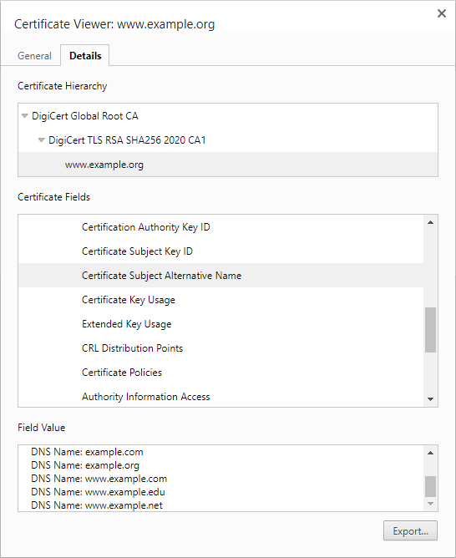
Root of Trust​
Root certificate
  Self-signed, so users must trust in the CA’s security procedures
Single CA​
  CA issues certificates directly to subjects
Hierarchical/chain of trust​
  Root CA​
  Intermediate CAs​
  Leaf certificates​
Self-signed certificates
  Use certificate security without PKI, but provide no root of trust
Screenshot used with permission from Microsoft.
Notes:
Show a certificate hierarchy for a website (such as example.org).
Show the trust store for a Windows or Linux PC or for a web browser.

Slide 16
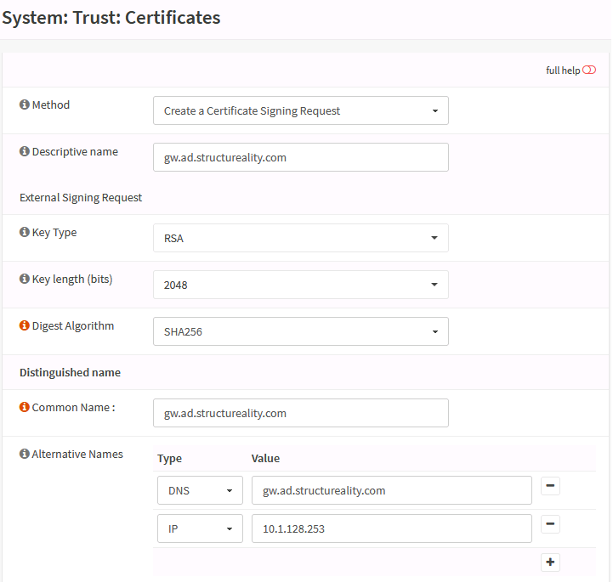
Certificate Signing Requests
Registration identification and authentication procedures​
Certificate Signing Request (CSR)​
  Subject generates key pair and sends public key to CA with CSR​
  Subject does NOT send private key: this must be kept known to the subject
  CA performs subject identity checks​
  CA signs and issues certificate​
Notes:
Note that the CA does not generate the key pair and that the private key is not part of the CSR. The private key must be kept securely on the host (or secure removable storage, such as a smart card).

Slide 17
Subject Name Attributes​
Common Name (CN)​
  Legacy method of recording fully qualified domain name (FQDN​)
  Deprecated by standards​
  BUT still used in many implementations​
Subject Alternative Name (SAN)​
  Structured identifiers​: name and/or IP address
  List multiple host/subdomains​
  Use wildcard subdomain​​
Screenshot used with permission from Microsoft.
Notes:
The SAN field MUST be configured with the FQDN.
Despite being deprecated for this usage, it is safer to duplicate this information in the CN (knowledge.digicert.com/solution/SO7239) to ensure compatibility.

Slide 18
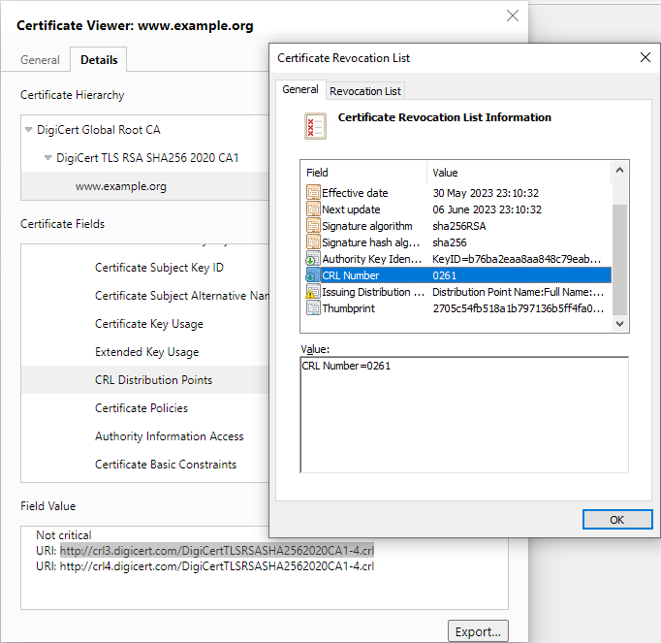
Certificate Revocation​
Revocation versus suspension​
Reason codes​
Certificate Revocation List (CRL)​
  List of revoked and suspended certificates​
  Browser CRL checking​
Online Certificate Status Protocol (OCSP) ​
  Client queries single certificate per transaction​
  Provide real-time status information (though some rely on CRLs)​
Screenshot used with permission from Microsoft.

Slide 19
Key Management​
Key lifecycle​
  Key generation​
  Storage​
  Revocation​
  Expiration and renewal​
Decentralized key management
  Each host or user account stores its own private key
Key management system
  Keys are generated and stored on a centralized server
  Key Management Interoperability Protocol (KMIP)
Notes:
We're focusing on PKI in this topic, but do note that symmetric keys and SSH keys have management requirements too. We'll be covering SSH later in the course.

Slide 20
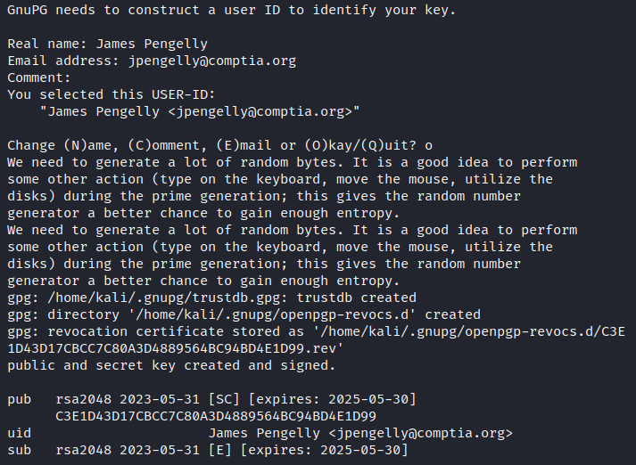
Cryptoprocessors and Secure Enclaves
Key generation challenges
  Entropy and random number generation
  Tamper-evident storage
Trusted Platform Module (TPM)​
  Cryptoprocessor implemented on CPU (or motherboard)
Hardware Security Module (HSM)​
  Cryptoprocessor in removable or dedicated hardware form factor (or virtual appliance)
  Reduced attack surface and tamper-evident​
Secure enclave
  Protect keys loaded in system memory

Slide 21
Key Escrow​
Keys can be backed up to protect against data loss​
Anyone with access to backup keys could impersonate the true key holder​
Escrow backup​
  Placing archived keys with a trusted third party​
M-of-N control
  Key recovery processes can be protected by M of N control​
  Split key into multiple parts held by different key recovery agents

Slide 22
Public Key Infrastructure
Certificate authorities​
Digital certificates​
Root of trust​
Certificate signing requests
Subject name attributes​
Certificate revocation​
Key management​
Cryptoprocessors and secure enclaves
Key escrow​

Slide 23
Cryptographic Solutions
Lesson 3
Topic 3C
Notes:
This topic collects the remaining content examples from objective 1.4.

Slide 24
Encryption Supporting Confidentiality
Data states
  Data at rest, data in transit, data in use
Bulk encryption
  Using a private asymmetric key is inefficient for large amounts of data
  Private key (key encryption key) is used to encrypt a symmetric key (media/data encryption key)
Notes:
Make sure students can distinguish the data states.

Slide 25
Disk and File Encryption
Data at rest storage levels
Full disk and partition encryption
  Encrypt whole disk or partition on disk
  Often performed by drive firmware (self-encrypting)
Volume and file encryption
  Often performed by OS/software
  Usually requires file system support
Notes:
We're drawing some distinctions among disk, partition, and volume encryption that aren't necessarily observed in the marketplace. Most products are just sold as disk/drive/device encryption.

Slide 26
Database Encryption
Structured data
  Tables, columns (fields), and rows (records)
  Database Management System (DBMS)
    Structured Query Language (SQL)
Database-level encryption
  Page-level decryption and encryption as data is moved from disk to memory
Record-level encryption
  Cell/column versus record-level
  Enforce fine-grained access controls to support compliance requirements for privacy/security

Slide 27
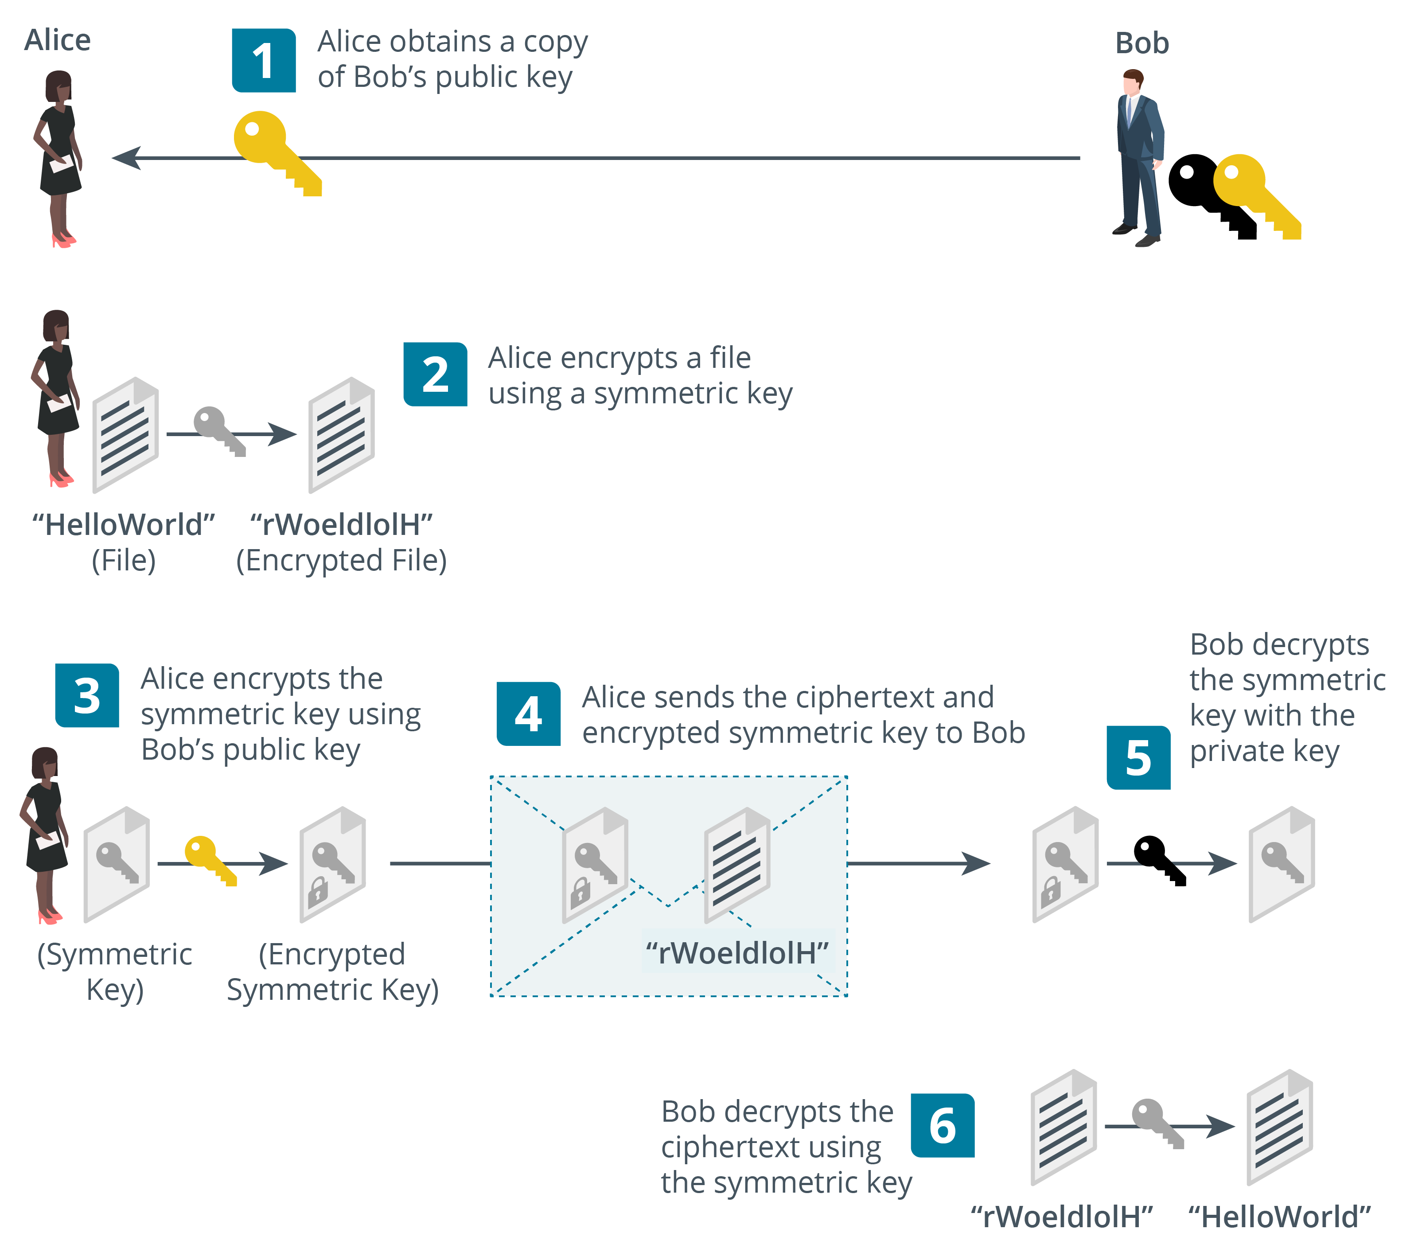
Transport Encryption and Key Exchange
Notes:
HMAC and authenticated encryption aren't content examples, but they seem worth mentioning. HMAC is in the acronyms list.

Slide 28
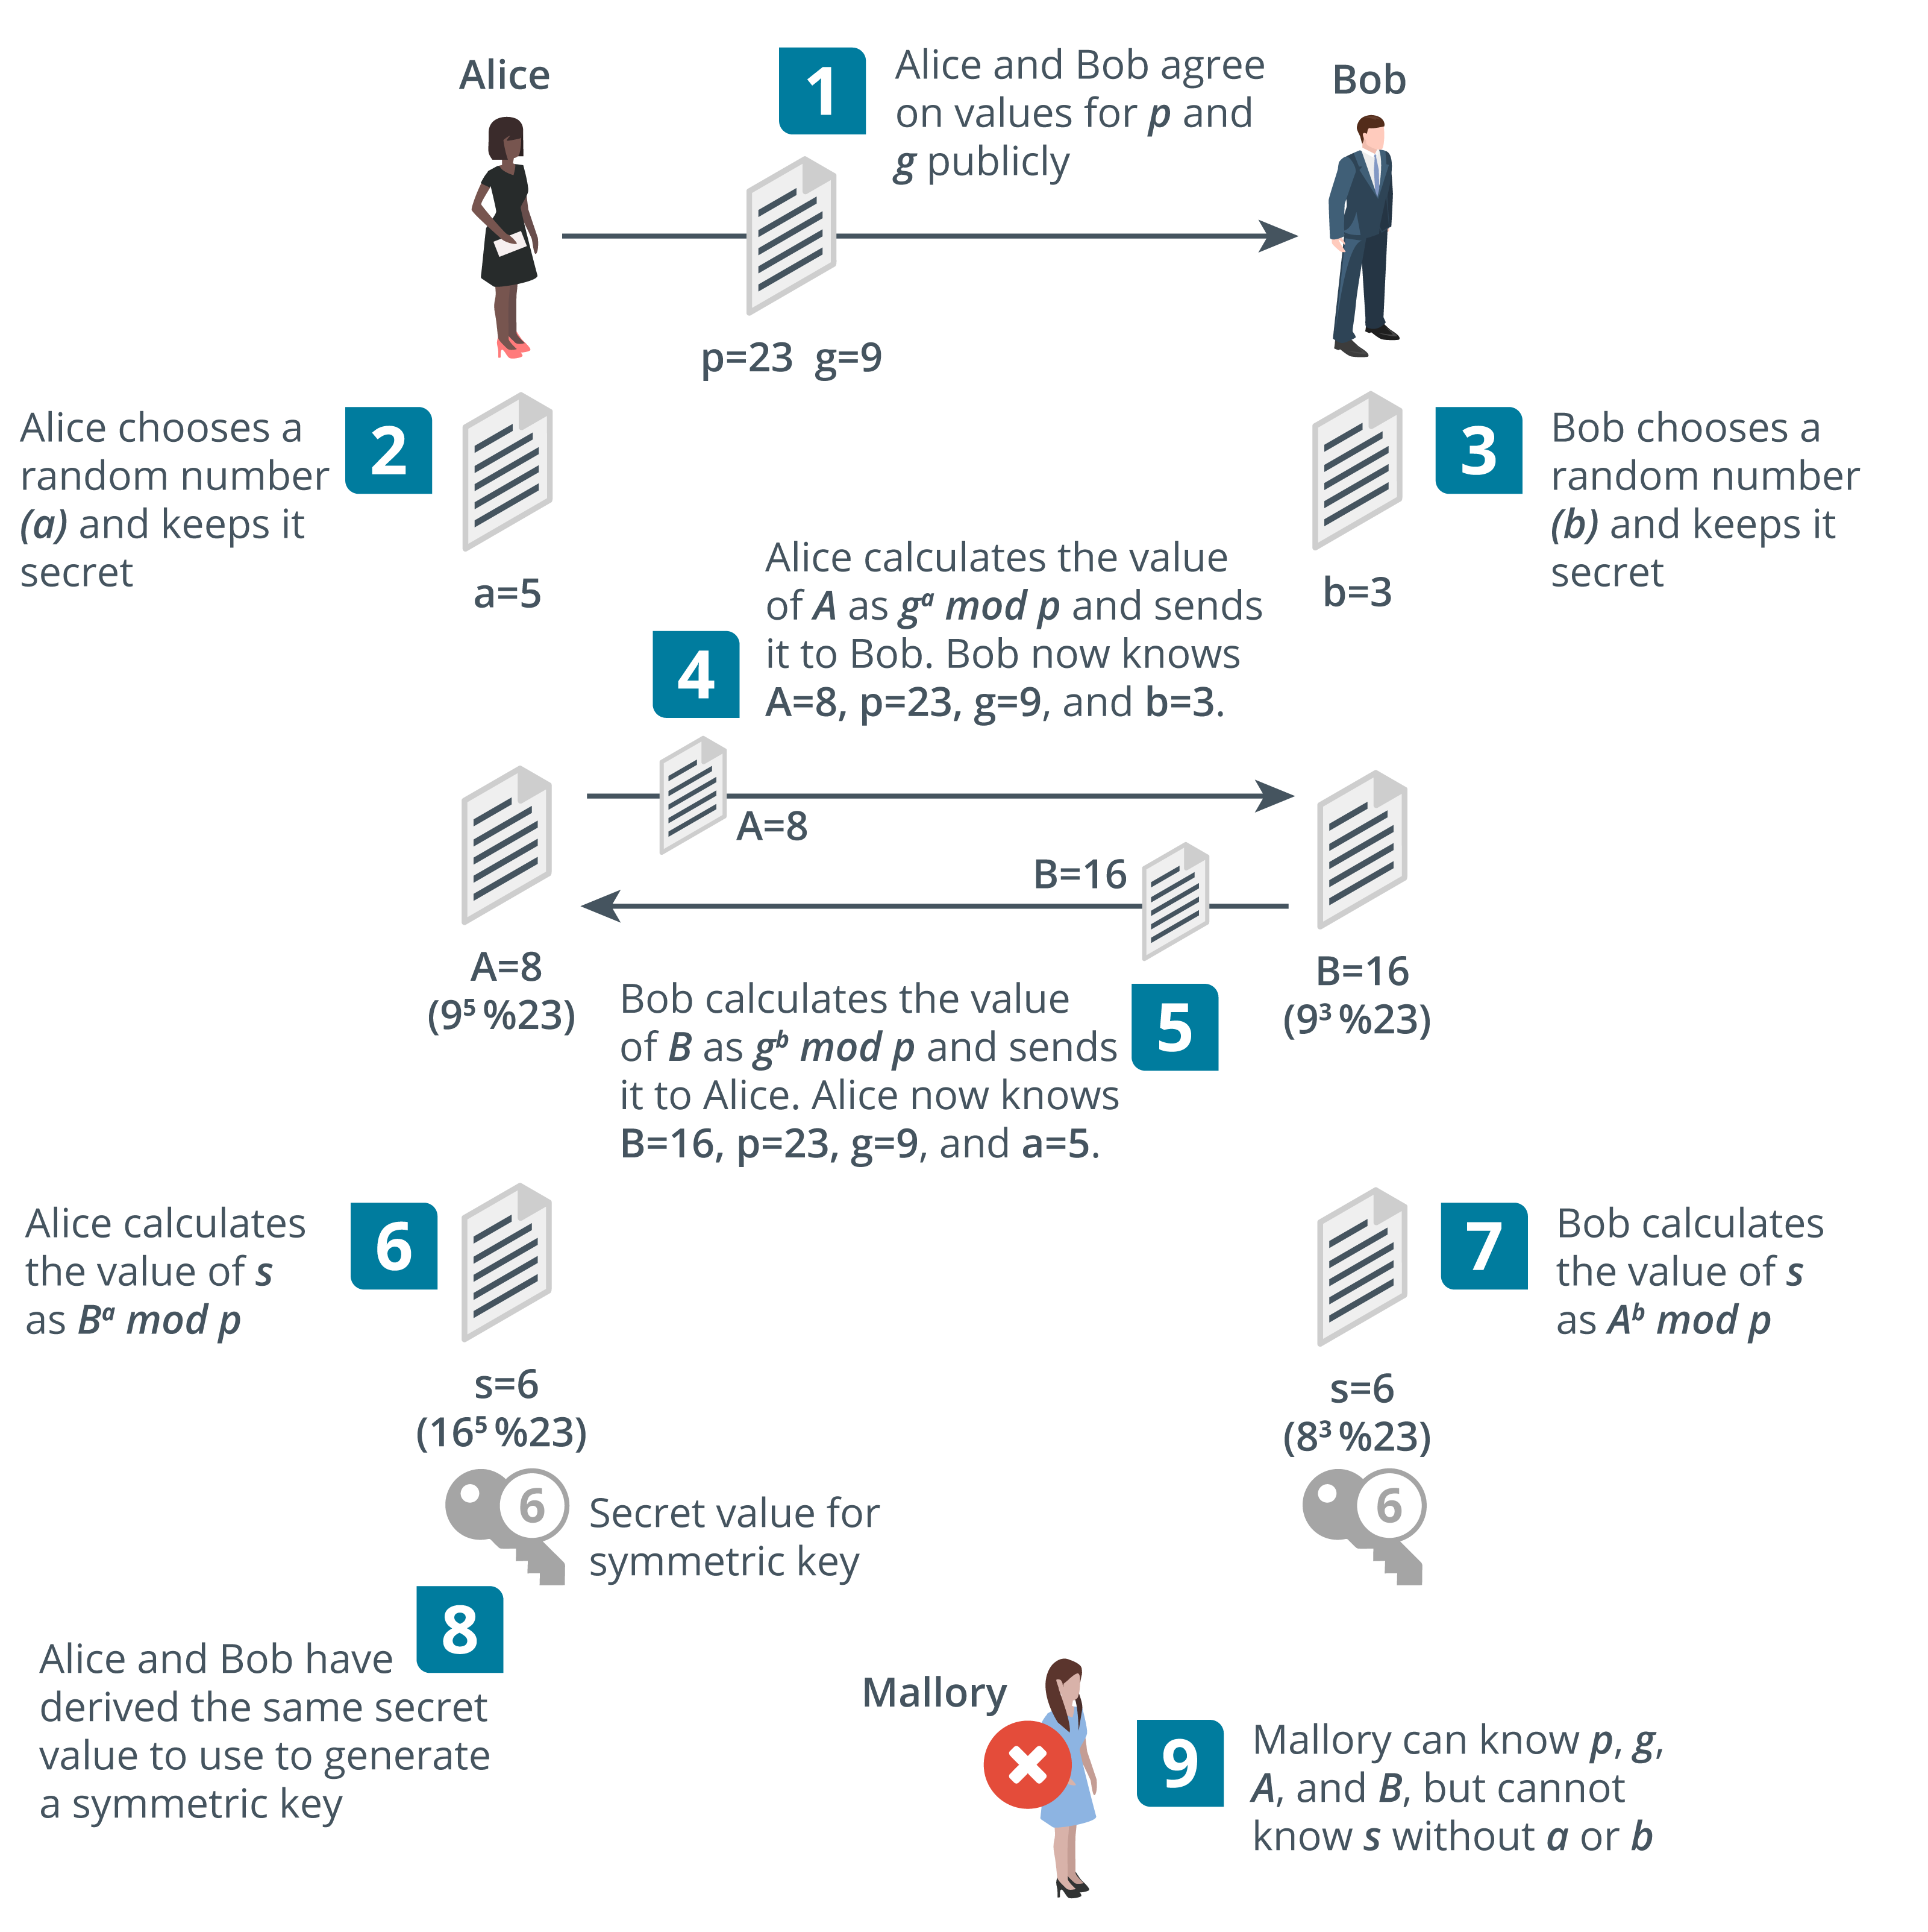
Perfect Forward Secrecy
Notes:
The exam objectives only mention "key exchange," but PFS is so critical to modern security it needs covering.
The terms "key exchange" and "key agreement" are often taken to mean the same thing, but point out that there are different mechanisms. With key agreement, the client does not transmit an encrypted session key to the server. The client and server use Diffie-Hellman (D-H) to derive the same secret key value.
Note that in TLS 1.3, only PFS cipher suites are allowed. RSA key exchange is deprecated. The RSA algorithm can still be used for signing, however. The values exchanged as part of D-H need to be signed to prove authenticity and prevent an on-path attack.

Slide 29
Salting and Key Stretching
Password hashes
User-generated data is low entropy​
  Brute force attack discovers value by generating every possible value and finding a match
Salting​
  Add a random value to each password when hashing it for storage​
  Prevents use of pre-computed hash tables​
Key stretching​
  Use additional rounds to strengthen keys​
  Makes attacker do more work, so slows down brute force​​

Slide 30
Blockchain
Expanding list of transactional records (blocks)​
Each block is linked by hashing​
Open public ledger​
Ledger of transactions performed on a digital asset​
Peer-to-peer so transactions are public​
Transactions cannot be deleted or reversed​
Widely used for cryptocurrencies​
Potential uses for financial transactions, online voting systems, identity management systems, notarization, data storage, …​

Slide 31
Obfuscation
Steganography
  Concealing messages within a covertext​
  Often uses file data that can be manipulated without introducing obvious artifacts​
  Covert channels​
Data masking
  Redacting information from fields
Tokenization
  Substituting data with token
  Reversible with access to the token server
De-identification
Notes:
There are various software applications for inserting and detecting steganographic messages. When hiding messages in files, a substitution technique such as least significant bit is preferable to simply inserting a message as it does not alter the file size.

Slide 32
Cryptographic Solutions
Encryption supporting confidentiality
Disk and file encryption
Database encryption
Transport encryption and key exchange
Perfect forward secrecy
Salting and key stretching
Blockchain
Obfuscation

Slide 33
Assisted Lab: Using Hashing and Salting

Slide 34
Summary
CompTIA Security+ Exam SY0-701
Lesson 3
Notes:
Check that students are confident about the content that has been covered. If there is time, revisit any content examples that they have questions about. If you have used all the available time for this lesson block, note the issues and schedule time for a review later in the course.
Split students into groups and have each investigate a different third-party CA. Identify whether the CA's website provides all of the following:
Type of certificates offered, such as: TLS (including multidomain and wildcard), code-signing, S/MIME/email, ...
Certificate Practice Statement (establishing trust)
Advice on key pair generation and length and on submitting a CSR
Advice on cipher suites for PFS

